Slide 1
CWE/CAPEC User Experience Working Group Meeting
October 19, 2022

Slide 2
Agenda
Housekeeping
Primary topics
Review CWE & CAPEC recent content releases
Feedback: Personas and Presentation Filters
Discussion: Possible opportunities for UEWG Activity
Reminders and Adjourn
This meeting is being recorded :-)

Slide 3
UEWG: Reminders
Mission: Identifying areas where CWE/CAPEC content, rules, guidelines, and best practices must improve to better support stakeholder community, and work collaboratively to fix them
Periodic reporting of activities to CWE/CAPEC Board
(next quarterly Board meeting TBD Q1-2023)
Please solicit participations from your contacts
Contact: cwe@mitre.org & capec@mitre.org

Slide 4
Housekeeping
We are working to identify further UEWG opportunities and priorities for FY23
Open discussion today, Topic #3
(Underway) Collaborative CWE/CAPEC content development space collaboration space
Board provided final comments on personas list and definitions

Slide 5
Topic
CWE & CAPEC Recent Releases Review
Rich Piazza – CAPEC v3.8
Steve Christey Coley – CWE v4.9

Slide 6
CAPEC v3.8
Created the new view of Supply Chain CAPEC entries based on the CISA supply chain life cycle
New CAPECs for Supply Chain domain:
CAPEC-690: Metadata Spoofing, CAPEC-691: Spoof Open-Source Software Metadata,CAPEC-692: Spoof Version Control System Commit Metadata,CAPEC-693: StarJacking, CAPEC-695: RepoJacking
New CAPECs for Hardware domain:
CAPEC-682: Exploitation of firmware or ROM code with un-patchable vulnerabilities
CAPEC-696: Load Value Injection
Other new CAPECs:
CAPEC-694: System Location Discovery
CAPEC-697: DHCP Spoofing
Updated CAPEC to ATT&CK mapping

Slide 7
Summary of CWE v4.9 Changes
Maintenance-heavy release
693 entries modified (most in small ways)
6 new entries
1 view deprecated
Diff report available:
https://cwe.mitre.org/data/reports/diff_reports/v4.8_v4.9.html
One comment: the diff reports don’t work very well to show details about how entries were changed

Slide 8
Software Content Changes for CWE 4.9
External content submissions
Miscellaneous modifications
New entry CWE-1389: Incorrect Parsing of Numbers with Different Radices
New areas: cloud, ICS/OT
ICEFALL (ICS/OT) CVEs – observed examples
Cloud – modify existing entries
Demonstrative examples (real-world incidents) have few weakness details
Integrate outputs from Top 25 remapping
Modify view 1003
Mapping notes - prohibit/discourage mapping to commonly-misused CWEs

Slide 9
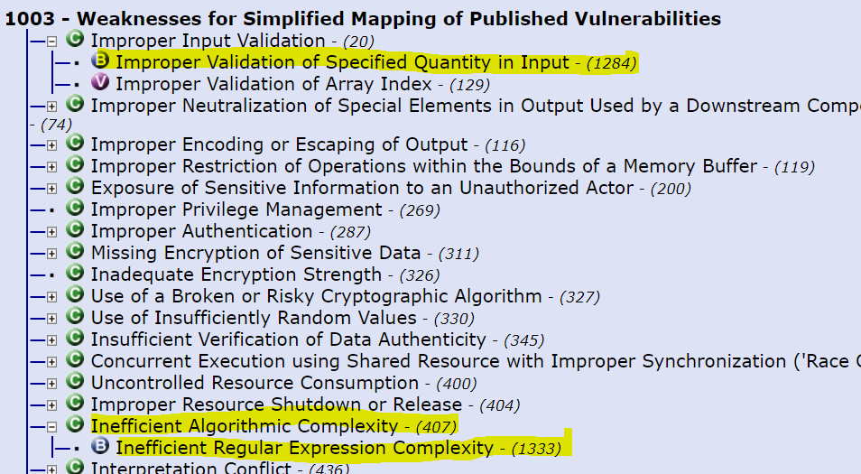
View 1003 changes

Slide 10
Software Content Changes for CWE 4.9 (Continued)
New CWE entries
Access control subtree overhaul
“Weak Authentication,” “Weak Credentials,” etc. (see next slide)
Expand observed example coverage
CVEs in software written in Go or Python
xhtml cleanup for CWE REST API
Fix minor inconsistencies and rendering problems in xhtml
Software Fault Patterns view updates (888)
Minor schema changes
Consistent capitalization, changing terms, etc.
Many other modifications

Slide 11
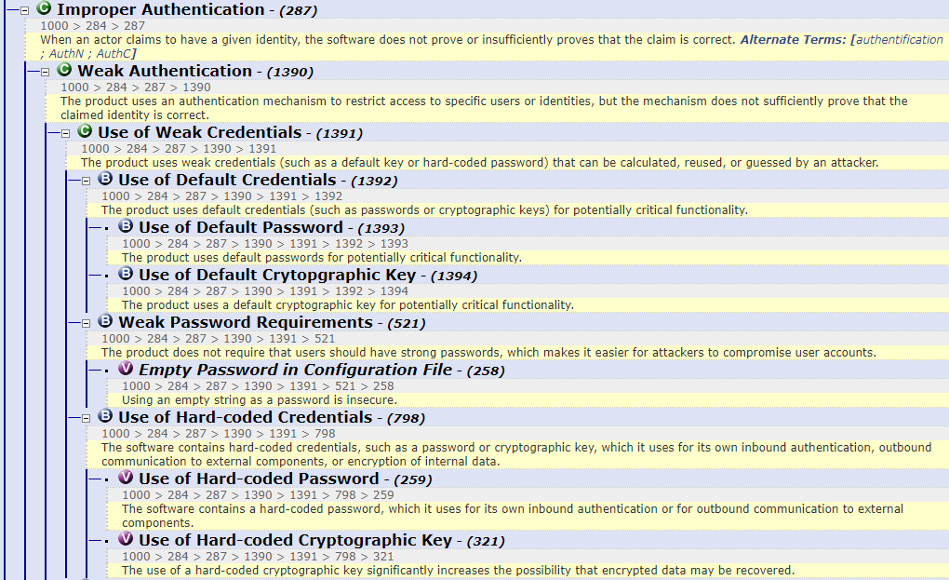
Access Control Enhancements – Weak Authentication
“Improper” -> “Missing” or “Incorrect” (Weak)
“Incorrect AuthN” could only use more-general CWE-287
Others like authZ have had this distinction for a long time
Use of Weak Credentials (CWE-1391) is a key breakdown from other authN issues
Entries are incomplete (to address in 4.10)
“software” -> “product”

Slide 12
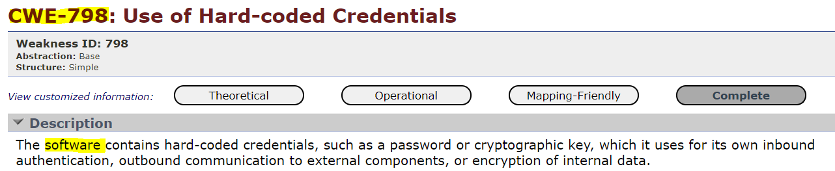
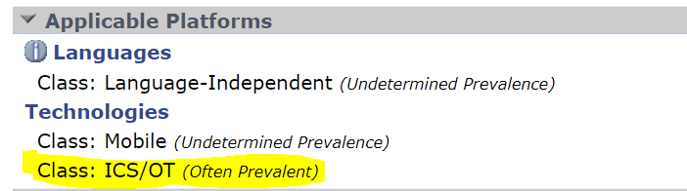
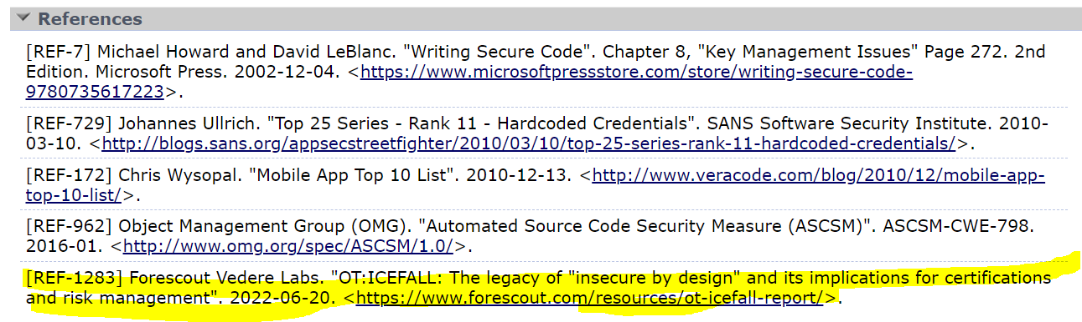
Example ICS/OT Change – CWE-798: Hard-Coded Credentials
change →

Slide 13
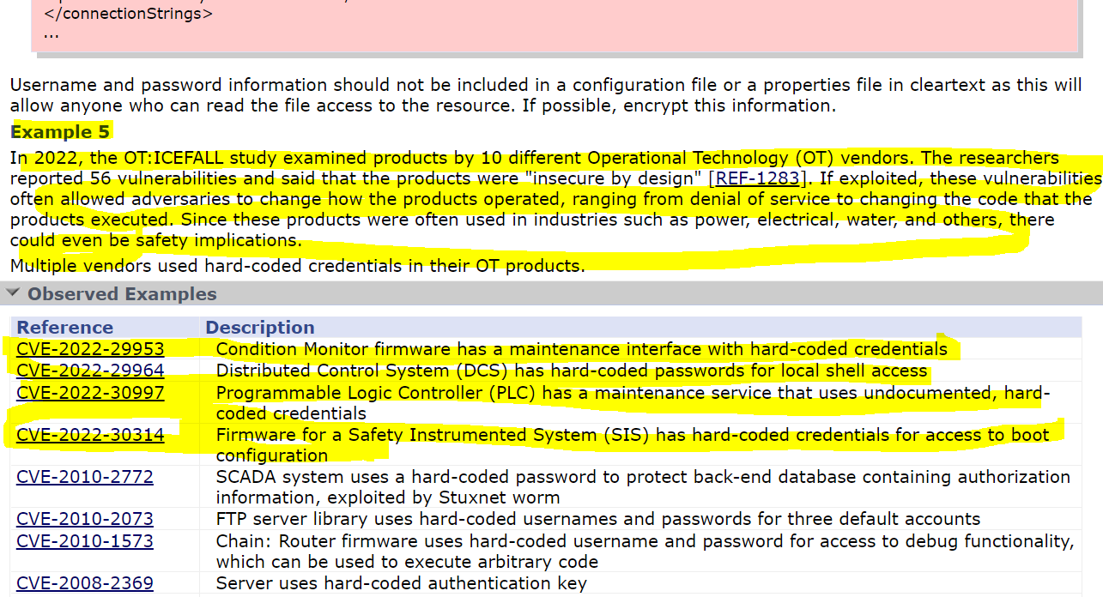
Example ICS/OT Change (2) – CWE-798: Hard-Coded Credentials

Slide 14
Hardware CWE 4.9 Changes
Re-categorized several CWEs as a result of the new CWE-1388 category from 4.8
Name changes for CWE-1206 Category (include “Thermal” as mentioned in description) and CWE-1320
Schema changes: “Not Technology-Specific”, new Language Class “HW Description Language”
Fixed/replaced erroneous demonstrative examples for CWE-1311 and CWE-1303
Fixed indenting in some code examples (related to REST API cleanup)
Changed some code example languages from “Other” to Verilog/VHDL
Added TI "Physical Security Attacks Against Silicon Devices“ reference to several CWE entries dealing with Fault Injection, Side Channels, and glitching
Other modifications
Ongoing: reorg related to processor issues (Spectre, Meltdown, etc.)

Slide 15
Topic 2
Feedback: Personas, Definitions, and Presentation Filters
Alec Summers

Slide 16
CWE/CAPEC User Personas
To be published on CWE/CAPEC sites in October pending approval
Educators: Teachers, professors, or certification programs that educate developers and system designers how to design more secure products, develop more secure code, and/or how to find vulnerabilities.
Hardware Designers/Verification Engineer: Those who create, integrate, or verify hardware components within the discipline of microelectronics and want to understand, detect, and avoid weaknesses.
Security Researchers/Analysts: Those who look for ways to attack a product by finding weaknesses using manual and/or automated techniques, then reporting the findings to the vendor and/or the general public.
Software Developers/Assurance Engineers: Those who create, maintain, and test software, using various languages and frameworks, who want to understand, detect, and avoid weaknesses
Technical Writers: Those who communicate advanced technical concepts as clearly, accurately, and comprehensively as possible to their intended audience (e.g., code analysis tool users or system designers)
Tool Developers: Developers of security products and services for finding weaknesses, attacking systems, and reporting findings to users

Slide 17


Modernizing Definitions on CWE/CAPEC Sites
Term | Definition | Authority | Authorities Doc
Vulnerability | A flaw in a software, firmware, hardware, or service component resulting from a weakness that can be exploited, causing a negative impact to the confidentiality, integrity, or availability of an impacted component or components | CVE | website
Weakness | A condition in a software, firmware, hardware, or service component that, under certain circumstances, could contribute to the introduction of vulnerabilities | n/a | edited from def on CWE website
Attack Pattern | The common approach and attributes related to the exploitation of a weakness in a software, firmware, hardware, or service component. | n/a | edited from def on CAPEC website

Slide 18
“View Customized Information”
Theoretical:
For users who are interested in the practical
Operational:
For users who are concerned with the practical application and details about the nature of the weakness and how to prevent it from happening
Mapping-Friendly:
For users who are mapping an issue to CWE/CAPEC IDs, i.e., finding the most appropriate CWE for a specific issue (e.g., a CVE record)
Complete:
For users who wish to see all available information for the CWE/CAPEC entry

Slide 19
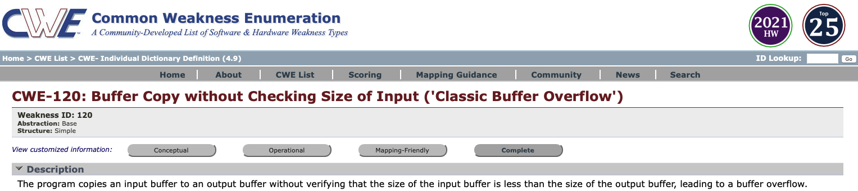
Screenshot

Slide 20
Adjusting our Presentation Filters
Better serve our user persona needs
“Two-Types” Proposal by Premyslaw Roguski (Red Hat)
Theoretical: users who are more focused on the theoretical aspects of the weaknesses
Educators (teachers, professors, solution architects who design the systems' requirements)
Technical Writers (people responsible for security content, security blogs and articles)
Project and Program Managers who need some level of understanding about security and weaknesses
Technical: users who are managing the security issues and need more details about the nature of the weakness and how to prevent this from happening
Tool Developers, Security Researchers, Pentesters, Incident Response Analysts

Slide 21
Proposed Data Elements for Each Group
Theoretical:
Description, Extended Description, Alternate Terms, Common Consequences
Technical (operational?):
Description, Extended Description, Alternate Terms, Modes of Introduction, Demonstrative Examples, Observed Examples (include recent CVE tracking data*), Potential Mitigations, Relationships
Mapping-Friendly:
Description, Extended Description, Alternate Terms, Modes of Introduction, Likelihood of Exploitation, Taxonomy Mappings, Memberships, Notes
Complete:
all

Slide 22
Screenshot
Thoughts? Comments?

Slide 23
Customizing CAPEC Information
Currently
Basic, Complete
Would the new CWE model for filters work for CAPEC?
Conceptual
Operational
Mapping-Friendly
Complete
CAPEC CONTENT
BASIC | COMPLETE
Description | Description
Extended_Description | Extended_Description
Relationships | Relationships
Execution_Flow | Execution_Flow
Prerequisites | Prerequisites
Mitigations | Mitigations
Related_Weaknesses | Likelihood_Of_Attack
 | Alternate_Terms
 | Typical_Severity
 | Skills_Required
 | Resources_Required
 | Indicators
 | Consequences
 | Example_Instances
 | Related_Weaknesses
 | Taxonomy_Mappings
 | References
 | Notes
 | Content_History

Slide 24
Topic 3
Possible UEWG Activities and Focus Areas
Open Discussion

Slide 25
UEWG Activities Brainstorm
Other potential opportunities:
Improve CWE and CAPEC usability
Features we could implement / expand
Engaging other users?
Engaging other working groups?
Other thoughts?

Slide 26
Next Meeting – November 16 @ 12pm
PLEASE CONTACT WITH ANY QUESTIONS OR THOUGHTS
CWE@MITRE.ORG
CAPEC@MITRE.ORG

